Slide 1
“Secularism and Its Discontents”
Amartya Sen
Presented by:
Jaspal Kaur Matharu
Guest Faculty
Department of English
Gangadhar Meher University

Slide 2
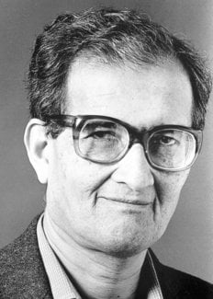
Amartya Sen
Amartya Sen, (born November 3, 1933, Santiniketan, India), Indian economist who was awarded the 1998 Nobel Prize in Economic Sciences for his contributions to welfare economics and social choice theory and for his interest in the problems of society’s poorest members. Sen was best known for his work on the causes of famine, which led to the development of practical solutions for preventing or limiting the effects of real or perceived shortages of food.

Slide 3
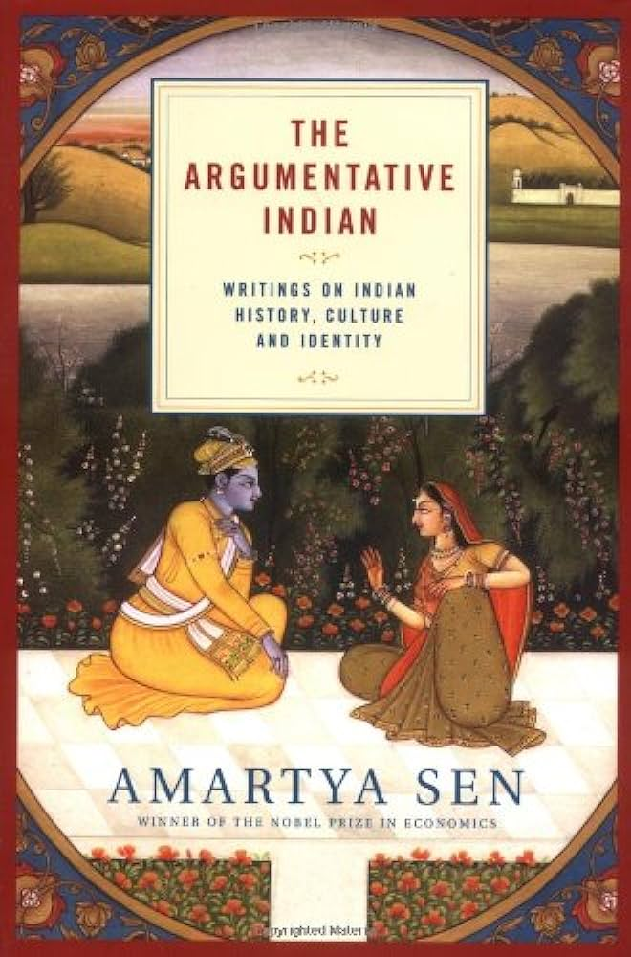
“Secularism and Its Discontents”
Secularism is the pillar of any democratic polity. It is the sin qua non of the modern nation-state. In India, it is more relevant than ever. However in the last eight years secularism has undergone a paradigmatic shift in its connotations. Secularism is perceived as a cuss word now at best and at worse a tool of appeasement of certain minorities. Ever since the Hindu nationalist government of Bharatiya Janta Party has come to power secularism has emerged as a contentious issue with numerous debates on the nature, interpretation and the historicity of the nature of secularism.

Slide 4
The nature of secularism as a principle calls for some clarification as well as scrutiny. Some of the choices considered under the heading of secularism lie, I would argue, beyond its immediate scope. Secularism in the political - as opposed to ecclesiastical - sense requires the separation of the state from any particular religious order. This can be interpreted in at least two different ways. The first view argues that secularism demands that the state be equidistant from all religions refusing to take sides and having a neutral attitude towards them. The second - more severe - view insists that the state must not have any relation at all with any religion. The equidistance must take the form, then, of being altogether removed from each.

Slide 5
Critical Arguments
Scepticism about Indian secularism takes many different forms. Amartya Sen consider in particular six distinct lines of argument, which are listed below:
The 'Non-existence' Critique
The ‘Favouritism’ Critique
The ‘Prior Identity’ Critique
The ‘Muslim Sectarianism’ Critique
The ‘Anti-modernist’ Critique
The ‘Cultural’ Critique

